Slide 1








CRICSHEET DATA DEEP DIVE: PLAYER TRENDS & TEAM DOMINANCE
Presented by Divya Joseph

Slide 2
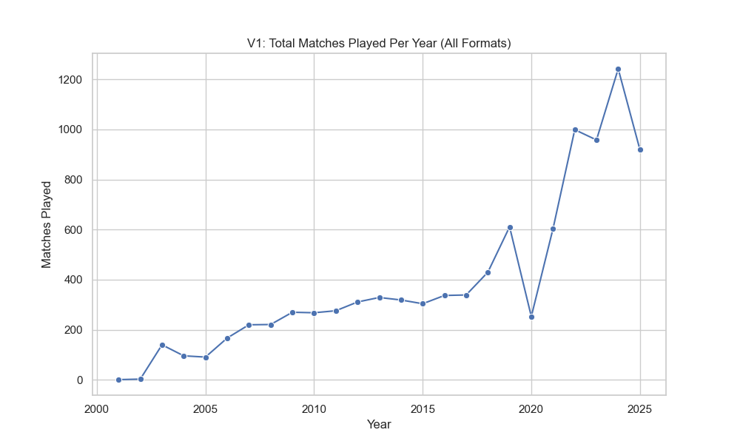
KEY TREND: MATCH VOLUME OVER TIME

Slide 3
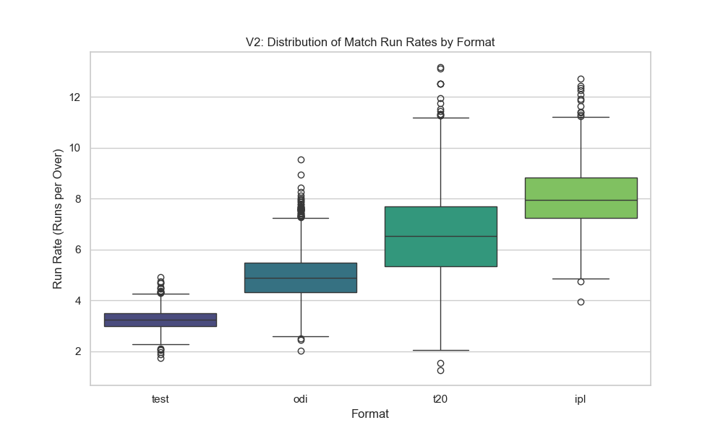
MATCH DYNAMICS: RUN RATE DISTRIBUTION

Slide 4
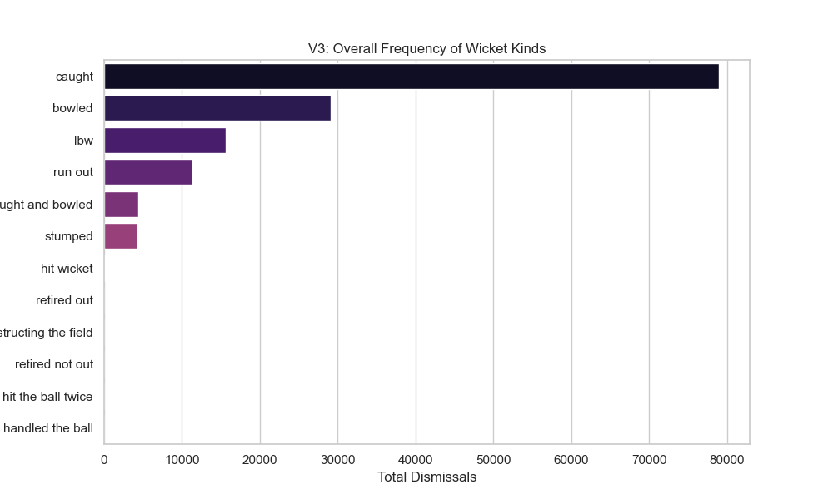
WICKET BREAKDOWN: DISMISSAL FREQUENCY

Slide 5
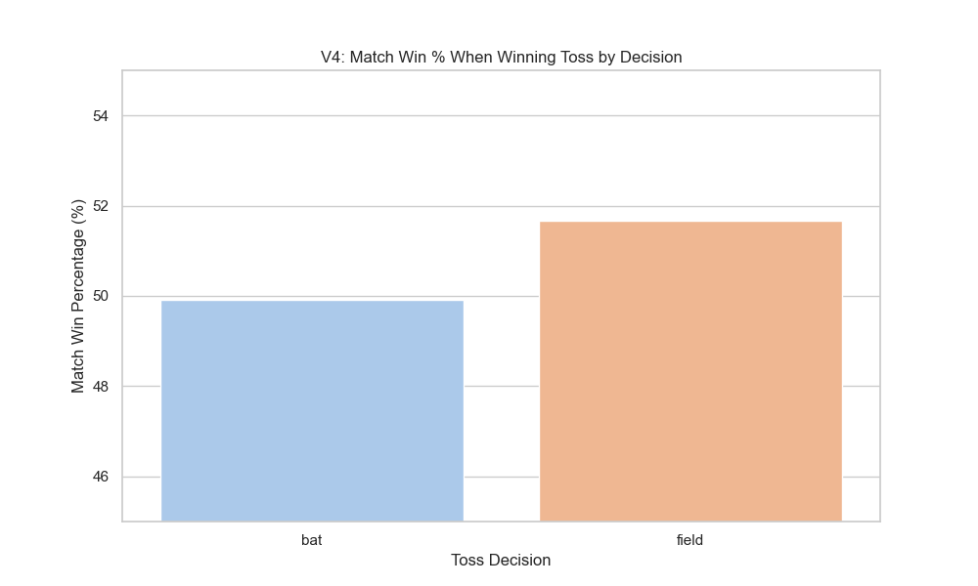
DECISION-MAKING: TOSS WIN IMPACT

Slide 6
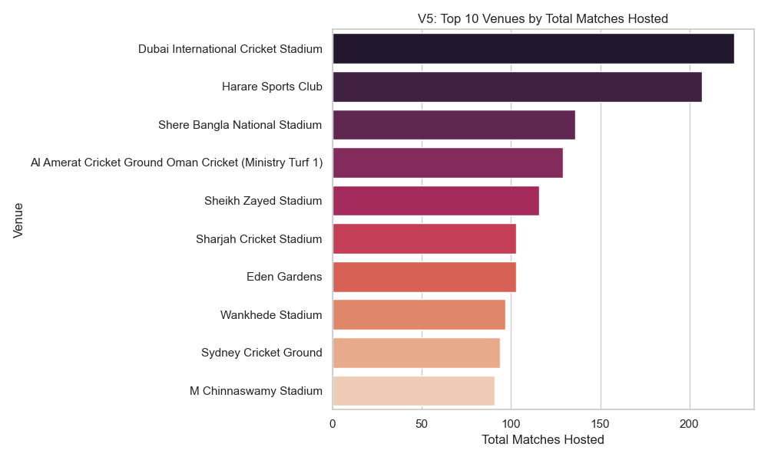
GLOBAL REACH: TOP VENUES BY MATCH COUNT

Slide 7
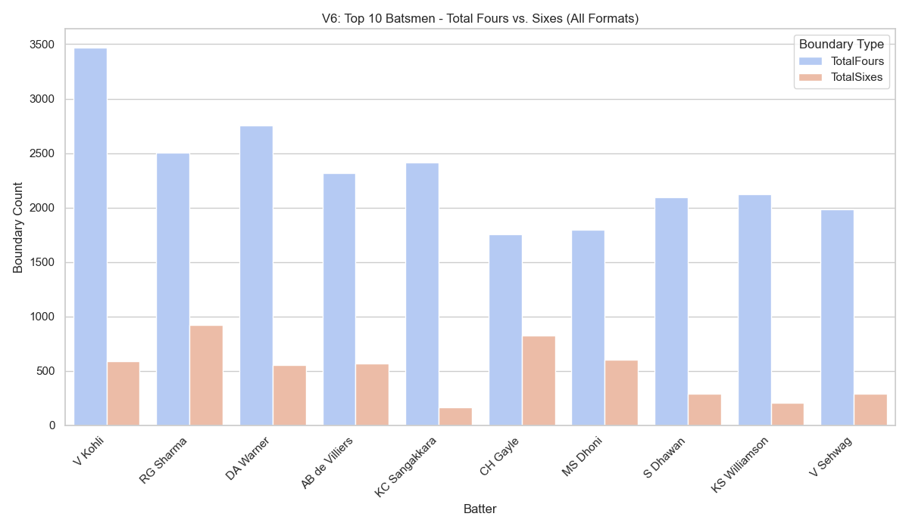
BATTING STYLES: FOURS VS. SIXES BREAKDOWN

Slide 8
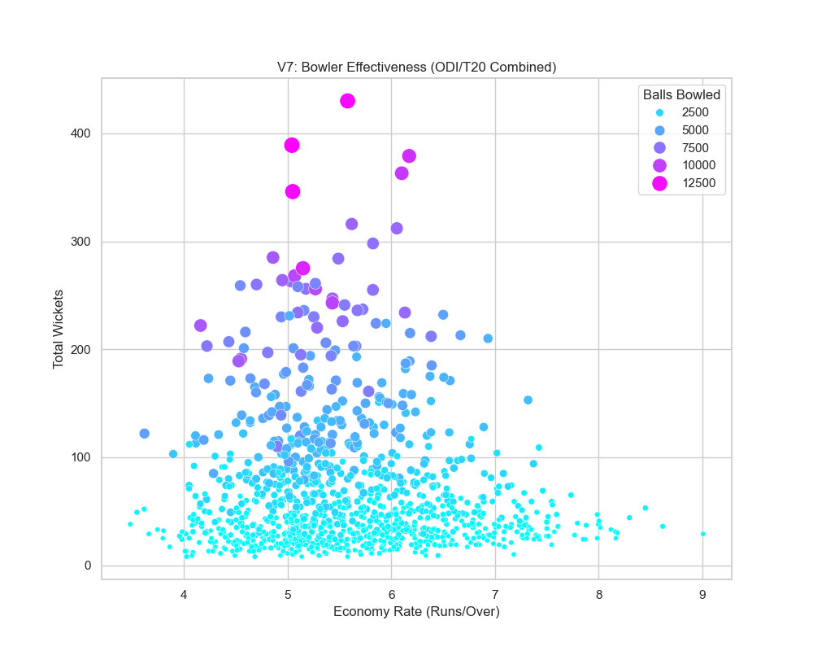
BOWLING ANALYSIS: WICKETS VS. ECONOMY

Slide 9
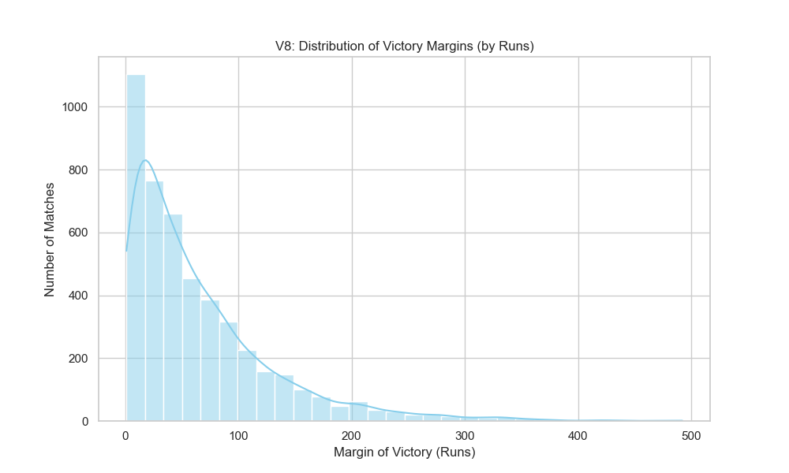
VICTORY MARGINS

Slide 10
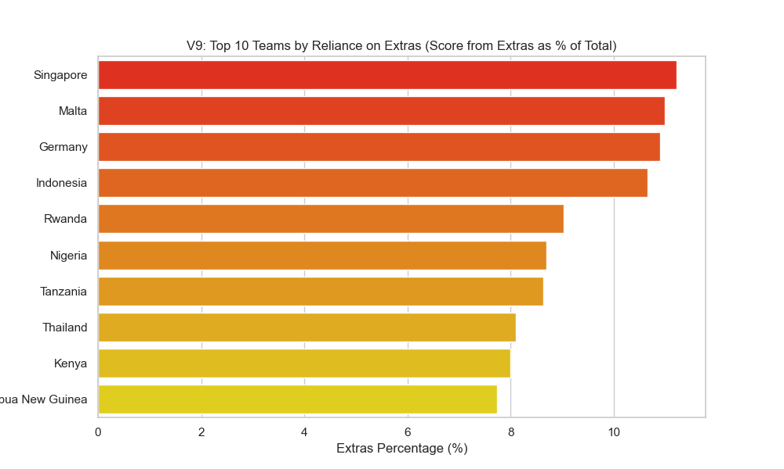
EXTRAS RELIANCE

Slide 11
CONCLUSION
T20 Dominance: The expansion of short-form cricket has fundamentally altered player specialization and made the 'Caught' dismissal the overwhelmingly dominant way batsmen lose their wicket.
Efficiency is Key: Player value is now best gauged by rate-based metrics (like average runs per match and Player of the Match awards) rather than traditional raw career totals.
Discipline Decides: Strategic factors like winning the toss are statistically marginal; true success is determined by team discipline (low extras reliance) in highly competitive, narrow-margin victories.

Slide 12
THANK
YOU

